Slide 1

WEEK 12 Integrating data into dashboards lecture
Instructor: Yanan Wu
fALL 2025

Slide 2
12.1 ARCGIS DASHBOARD

Slide 3
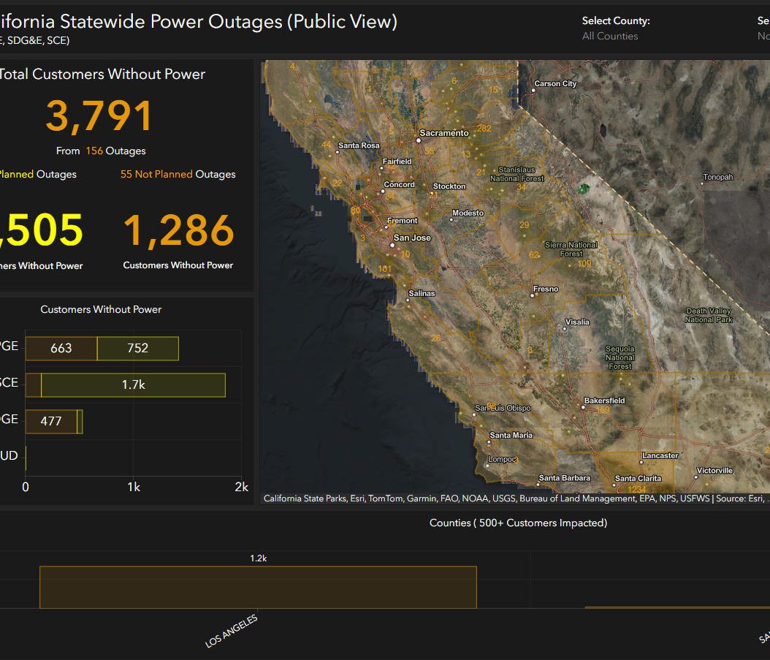
Arcgis dashboard gallery
https://www.arcgis.com/apps/dashboards/7edefc1970d44b839ebbfd7b45e51e2d

Slide 4
12.2 data

Slide 5
PRACTICE – GET THE DATA FROM THE CITY OF DALLAS OPEN DATA API

Slide 6
Arcgis dashboard

Slide 7
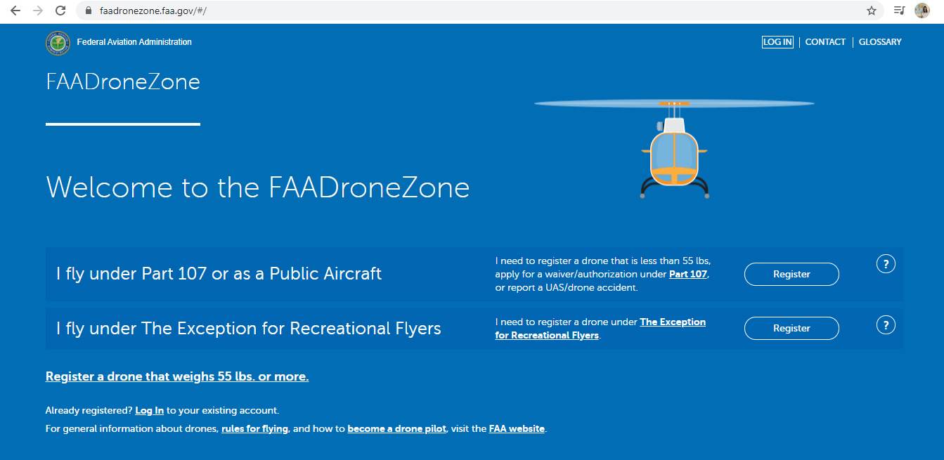
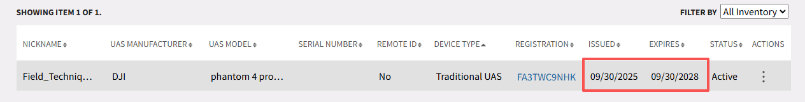
API
All drones weight more than .55 pounds must be registered
The only real, valid drone registration site is faadronezone.faa.gov
Any other site purporting to ‘help’ or ‘streamlining’ your registration is fake

Slide 8

Thank you!

